Slide 1
Functions
Course Code: CSC1102 &1103
Course Title: Introduction to Programming
Dept. of Computer Science
Faculty of Science and Technology
Lecturer No: | 8 | Week No: | 6 (2X1.5 hrs) | Semester:
Lecturer: | Syeda Nishat Tasnim(nishat@aiub.edu)

Slide 2
Lectures 8: Outline
Functions
Defining a Function
Arguments and Local Variables
Automatic Local Variables
Returning Function Results
Declaring a Function Prototype
Functions and Arrays
Arrays as parameters
Sorting Arrays
Multidimensional Arrays
Global Variables
Automatic and Static Variables
Recursive Functions

Slide 3
What is a function
A function is a self-contained unit of program code designed to accomplish a particular task.
The concept has some equivalent in all high-level programming languages: functions, subroutines, and procedures
The use of a function: a "black box"
defined in terms of the information that goes in (its input) and the value or action it produces (its output).
what goes on inside the black box is not your concern, unless you are the one who has to write the function.
What kind of “output” comes out from a function black box ?
Some functions find a value for a program to use.
Some functions cause an action to take place.
In general, a function can both produce actions and provide values.

Slide 4
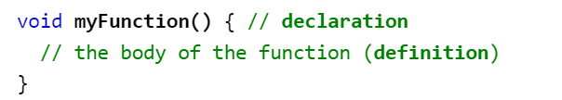
Function
A C++ function consist of two parts:
Declaration: the return type, the name of the function, and parameters (if any)
Definition: the body of the function (code to be executed)

Slide 5
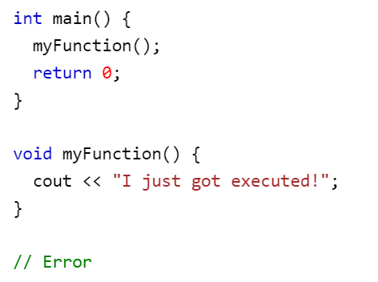
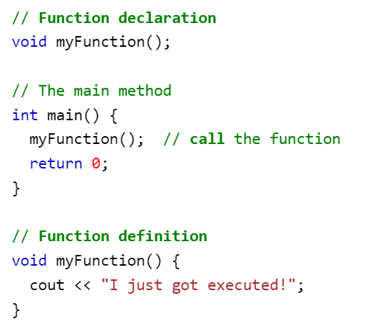
Function

Slide 6
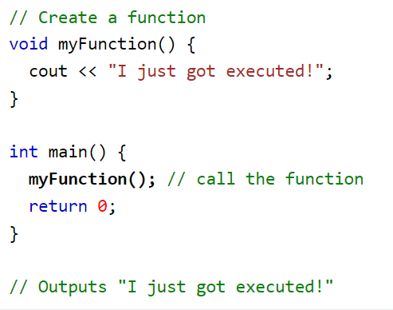

Function

Slide 7
Defining a function
#include <iostream>
using namespace std;
void printMessage (void)
{
cout<<"Programming is fun“<<endl;
}
int main (void)
{
printMessage ();
printMessage ();
return 0;
}
Function
Definition
occurs ONE time for all
outside other functions
Function
calls (invocations)
occurs ANY (0-N) times
statement inside (other) functions body

Slide 8
Transfer of control flow
main
printMesage
printf
{
{
{
}
}
When a function call is executed, program execution is transferred directly to the indicated function. After the called routine is finished (as signaled by the closing brace) the program returns to the calling routine, where program execution continues at the point where the function call was executed.

Slide 9
Function definitions
General form of function definition:
return-type function-name(argument declarations)
{
declarations and statements
}
return-type
arguments
void printMessage ( void )
{
cout<<"Programming is fun";
}
Void functions do not have a return type, but they can do return values.

Slide 10
Function prototype
The first line of the function definition
Contains everything that others (other functions) need to know about the function in order to use it (call it)
void printMessage (void)
void calculateTriangularNumber (int n)
Function prototype
return-type function-name(argument declarations)
{
declarations and statements
}

Slide 11
Function arguments
arguments (parameters): a kind of input for the function blackbox
In the function definition: formal arguments (formal parameters)
Formal parameter: a name that is used inside the function body to refer to its argument
In the function call: actual arguments (actual parameters)
The actual arguments are values are assigned to the corresponding formal parameters.
The actual argument can be a constant, a variable, or an even more elaborate expression.
The actual argument is evaluated, and its value is copied to the corresponding formal parameter for the function.
Because the called function works with data copied from the calling function, the original data in the calling function is protected from whatever manipulations the called function applies to the copies.

Slide 12
Example: arguments
// Function to calculate the nth triangular number
#include <iostream>
using namespace std;
void calculateTriangularNumber ( int n )
{
int i, triangularNumber = 0;
for ( i = 1; i <= n; ++i )
triangularNumber += i;
cout<<"Triangular number "<<n <<" is " <<triangularNumber<<endl;
}
int main (void)
{
calculateTriangularNumber (10);
calculateTriangularNumber (20);
calculateTriangularNumber (50);
return 0;
}
formal argument
local variables
actual argument

Slide 13
Arguments and local variables
Variables defined inside a function: automatic local variables
they are automatically “created” each time the function is called
their values are local to the function:
The value of a local variable can only be accessed by the function in which the variable is defined
Its value cannot be accessed by any other function.
If an initial value is given to a variable inside a function, that initial value is assigned to the variable each time the function is called.
Formal parameters: behave like local variables, private to the function.
Lifetime: Period of time when memory location is allocated
Scope: Region of program text where declaration is visible
Scope: local variables and formal parameters => only in the body of the function
Local variable i in function calculateTriangularNumber is different from a variable i defined in another function (including main)
Formal parameter n in function calculateTriangularNumber is different from a variable n defined in another function

Slide 14
Automatic local variables
main
calculateTriangularNumber
{
{
}
10
n
20
i
50
triangularNb

Slide 15
Example: scope of local variables
#include <iostream>
using namespace std;
void f1 (float x) {
int n=6;
cout<< x+n<<endl;
}
int f2(void) {
float n=10;
cout<<n<<endl;
}
int main (void)
{
int n=5;
f1(3);
f2();
return 0;
}

Slide 16
Arguments are passed by copying values !
In a function call, the actual argument is evaluated, and its value is copied to the corresponding formal parameter for the function.
Because the called function works with data copied from the calling function, the original data in the calling function is protected from whatever manipulations the called function applies to the copies

Slide 17
Example: arguments
#include <iostream>
using namespace std;
void gcd (int u, int v){
int temp;
while ( v != 0 ) {
temp = u % v;
u = v;
v = temp;
}
cout<<u<<endl;
}
int main (void){
gcd (150, 35);
gcd (1026, 405);
gcd (83, 240);
return 0;
}

Slide 18
Example: arguments are passed by copying values !
#include <iostream>
using namespace std;
void gcd (int u, int v){
int temp;
while ( v != 0 ) {
temp = u % v;
u = v;
v = temp;
}
cout<<u<<endl;
}
int main (void)
{
int x=10,y=15;
gcd (x, y);
cout<<"x= "<<x<< "y= "<<y;
return 0;
}
The formal parameters u and v are assigned new values in the function
The actual parameters x and y are not changed !

Slide 19
Arguments by copying
main
multiplyBy2
{
{
}
y
7
14
x
7

Slide 20
Returning function results
A function in C can optionally return a single value
return expression;
The value of expression is returned to the calling function. If the type of expression does not agree with the return type declared in the function declaration, its value is automatically converted to the declared type before it is returned.
A simpler format for declaring the return statement is as follows:
return;
Execution of the simple return statement causes program execution to be immediately returned to the calling function. This format can only be used to return from a function that does not return a value.
If execution proceeds to the end of a function and a return statement is not encountered, it returns as if a return statement of this form had been executed. Therefore, in such a case, no value is returned.
If the declaration of the type returned by a function is omitted, the compiler assumes that the function returns an int !

Slide 21
Example: function result
/* Function to find the greatest common divisor of two nonnegative integer values and to return the result */
#include <iostream>
using namespace std;
int gcd (int u, int v)
{
int temp;
while ( v != 0 ) {
temp = u % v;
u = v;
v = temp;
}
return u;
}
int main (void)
{
int result;
result = gcd (150, 35);
cout<<"The gcd of 150 and 35 is "<< result<<endl;
result = gcd (1026, 405);
cout<<"The gcd of 1026 and 405 is "<< result<<endl;
cout<<"The gcd of 83 and 240 is "<< gcd (83, 240)<<endl;
return 0;
}

Slide 22
Function declaration
a function prototype—a declaration that states the return type, the number of arguments, and the types of those arguments.
Useful mechanism when the called function is defined after the calling function
The prototype of the called function is everything the compiler needs in order to be able to compile the calling function
In order to produce the executable program, of course that also the whole definition of the function body is needed, but this occurs later, in the process of linking

Slide 23
Examples: function declarations
In a function declaration you have to specify the argument type
inside the parentheses, and not its name.
You can optionally specify a “dummy” name for formal parameters after the type
if you want.
int gcd (int u, int v);
Or
int gcd (int, int);
void calculateTriangularNumber (int n);
Or
void calculateTriangularNumber (int);

Slide 24
Passing arrays as parameters
A whole array can be one parameter in a function
In the function declaration, you can then omit the specification of the number of elements contained in the formal parameter array.
The compiler actually ignores this part of the declaration anyway; all the compiler is concerned with is the fact that an array is expected as an argument to the function and not how many elements are in it.
Example: a function that returns the minimum value from an array given as parameter
int minimum (int values[10]);
We must modify the function definition if a different array size is needed !
int minimum (int values[]);
Syntactically OK, but how will the function know the actual size of the array ?!
int minimum (int values[], int numberOfElements);

Slide 25
Example: Passing arrays as parameters
// Function to find the minimum value in an array
#include <iostream>
using namespace std;
int minimum (int values[], int numberOfElements)
{
int minValue, i;
minValue = values[0];
for ( i = 1; i < numberOfElements; ++i )
if ( values[i] < minValue )
minValue = values[i];
return minValue;
}
int main (void)
{
int array1[5] = { 157, -28, -37, 26, 10 };
int array2[7] = { 12, 45, 1, 10, 5, 3, 22 };
cout<<"array1 minimum: "<< minimum (array1, 5)<<endl;
cout<<"array2 minimum: "<<minimum (array2, 7)<<endl;
return 0;
}

Slide 26
Array parameters are passed by reference !
Parameters of non-array type: passed by copying values
Parameters of array type: passed by reference
the entire contents of the array is not copied into the formal parameter array.
the function gets passed information describing where in the computer’s memory the original array is located.
Any changes made to the formal parameter array by the function are actually made to the original array passed to the function, and not to a copy of the array.
This change remains in effect even after the function has completed execution and has returned to the calling routine.

Slide 27
Example: Array parameters are passed by reference !
#include <iostream>
using namespace std;
void multiplyBy2 (float array[], int n)
{
int i;
for ( i = 0; i < n; ++i )
array[i] *= 2;
}
int main (void)
{
float floatVals[4] = { 1.2, -3.7, 6.2, 8.55};
int i;
multiplyBy2 (floatVals, 4);
for ( i = 0; i < 4; ++i )
cout<< floatVals[i];
return 0;
}

Slide 28
Global variables
A global variable declaration is made outside of any function.
It does not belong to any particular function. Any function in the program can then access the value of that variable and can change its value.
The primary use of global variables is in programs in which many functions must access the value of the same variable. Rather than having to pass the value of the variable to each individual function as an argument, the function can explicitly reference the variable instead.
There is a drawback with this approach: Because the function explicitly references a particular global variable, the generality of the function is somewhat reduced !
Global variables do have default initial values: zero

Slide 29
Example: global variables
#include <stdio.h>
int x;
void f1 (void) {
x++;
}
void f2 (void) {
x++;
}
int main(void) {
x=7;
f1();
f2();
cout<<x<<endl;;
}

Slide 30
Automatic and static variables
Automatic local variables (the default case of local vars) :
an automatic variable disappears after the function where it is defined completes execution, the value of that variable disappears along with it.
the value an automatic variable has when a function finishes execution is guaranteed not to exist the next time the function is called.
The value of the expression is calculated and assigned to the automatic local variable each time the function is called.
Static local variables:
If you place the word static in front of a variable declaration
“something that has no movement”
a static local variable—it does not come and go as the function is called and returns. This implies that the value a static variable has upon leaving a function is the same value that variable will have the next time the function is called.
Static variables also differ with respect to their initialization. A static, local variable is initialized only once at the start of overall program execution—and not each time that the function is called. Furthermore, the initial value specified for a static variable must be a simple constant or constant expression. Static variables also have default initial values of zero, unlike automatic variables, which have no default initial value.

Slide 31
Example: Automatic and static variables
// Program to illustrate static and automatic variables
#include <stdio.h>
void auto_static (void)
{
int autoVar = 1;
static int staticVar = 1;
cout<<staticVar<<autovar;
++autoVar;
++staticVar;
}
int main (void)
{
int i;
for ( i = 0; i < 5; ++i )
auto_static ();
return 0;
}

